Slide 1
DS 4300
Introduction to the Graph Data Model
Mark Fontenot, PhD
Northeastern University
Material referenced from Graph Algorithms - Practical Examples in Apache Spark and Neo4j by Needham and Hodler (O’Reilly Press, 2019)

Slide 2
What is a Graph Database
Data model based on the graph data structure
Composed of nodes and edges
edges connect nodes
each is uniquely identified
each can contain properties (e.g. name, occupation, etc)
supports queries based on graph-oriented operations
traversals
shortest path
lots of others

Slide 3
Where do Graphs Show up?
Social Networks
yes… things like Instagram,
but also… modeling social interactions in fields like psychology and sociology
The Web
it is just a big graph of “pages” (nodes) connected by hyperlinks (edges)
Chemical and biological data
systems biology, genetics, etc.
interaction relationships in chemistry

Slide 4
Basics of Graphs and Graph Theory

Slide 5
What is a graph?
Labeled Property Graph
Composed of a set of node (vertex) objects and relationship (edge) objects
Labels are used to mark a node as part of a group
Properties are attributes (think KV pairs) and can exist on nodes and relationships
Nodes with no associated relationships are OK. Edges not connected to nodes are not permitted.

Slide 6
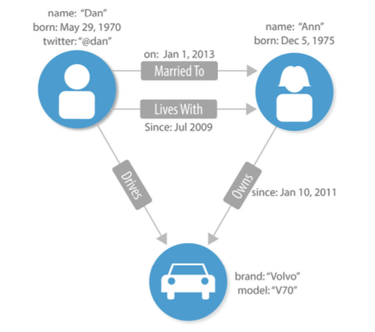
Example
2 Labels:
person
car
4 relationship types:
Drives
Owns
Lives_with
Married_to
Properties

Slide 7
Paths
A path is an ordered sequence of nodes connected by edges in which no nodes or edges are repeated.
1
3
2
Ex: 1 → 2 → 6 → 5
Not a path:
1 → 2 → 6 → 2 → 3
6
4
5

Slide 8
Flavors of Graphs
Connected (vs. Disconnected) – there is a path between any two nodes in the graph
Weighted (vs. Unweighted) – edge has a weight property (important for some algorithms)
Directed (vs. Undirected) – relationships (edges) define a start and end node
Acyclic (vs. Cyclic) – Graph contains no cycles

Slide 9
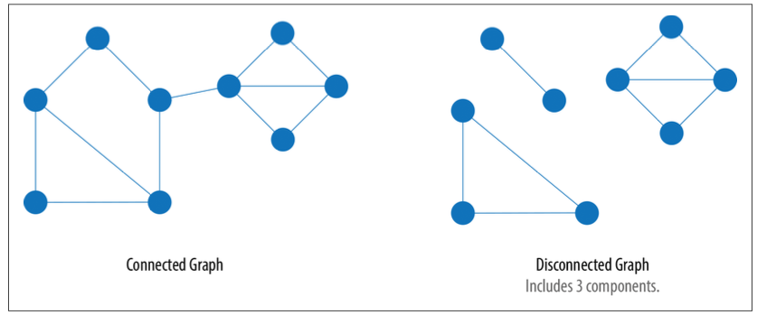
Connected vs. Disconnected

Slide 10
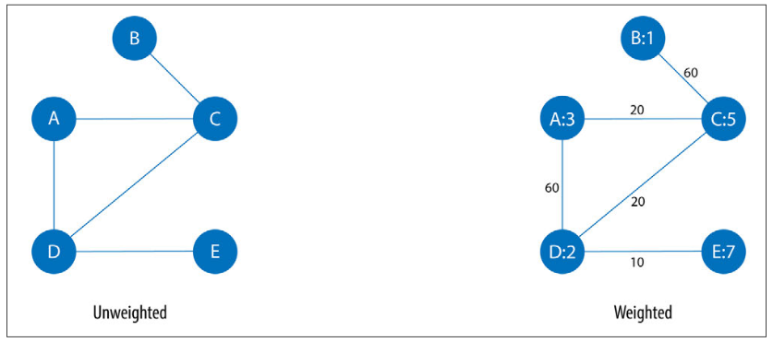
Weighted vs. Unweighted

Slide 11
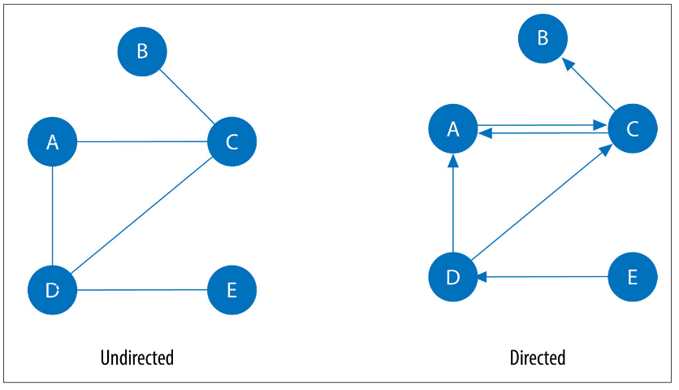
Directed vs. Undirected

Slide 12
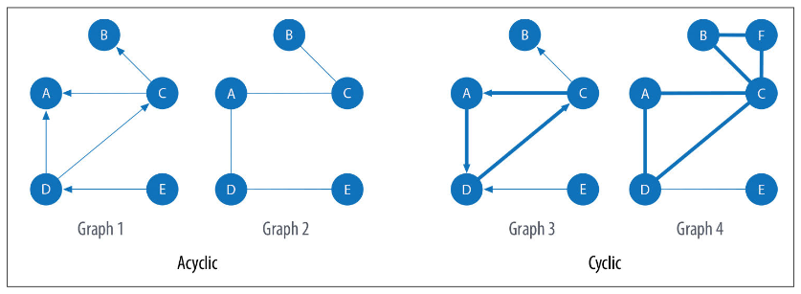
Cyclic vs Acyclic

Slide 13
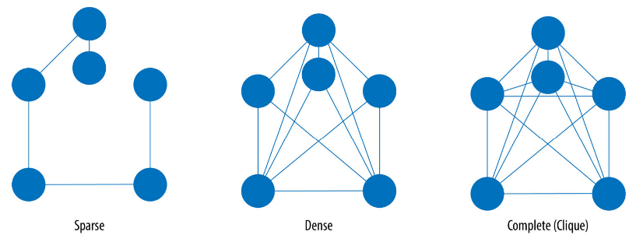
Sparse vs. Dense

Slide 14
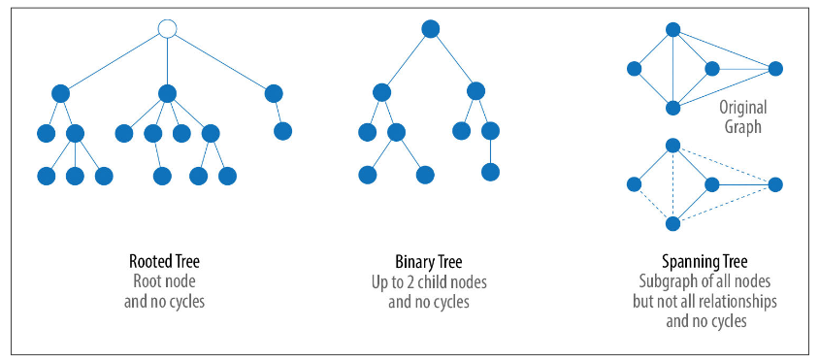
Trees

Slide 15
Types of Graph Algorithms - Pathfinding
Pathfinding
finding the shortest path between two nodes, if one exists, is probably the most common operation
“shortest” means fewest edges or lowest weight
Average Shortest Path can be used to monitor efficiency and resiliency of networks.
Minimum spanning tree, cycle detection, max/min flow… are other types of pathfinding

Slide 16
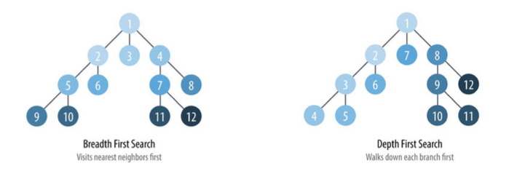
BFS vs DFS

Slide 17
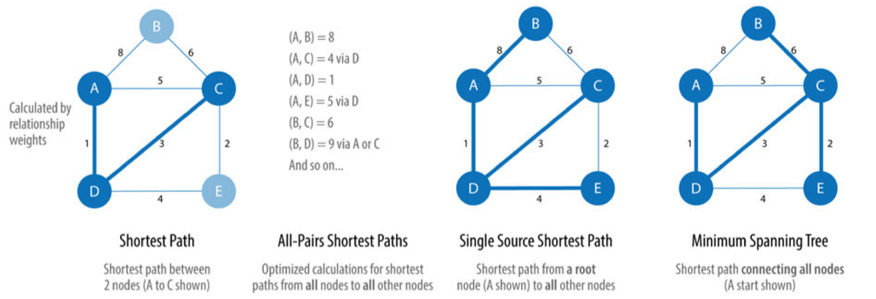
Shortest Path

Slide 18
Types of Graph Algorithms - Centrality & Community Detection
Centrality
determining which nodes are “more important” in a network compared to other nodes
EX: Social Network Influencers?
Community Detection
evaluate clustering or partitioning of nodes of a graph and tendency to strengthen or break apart

Slide 19
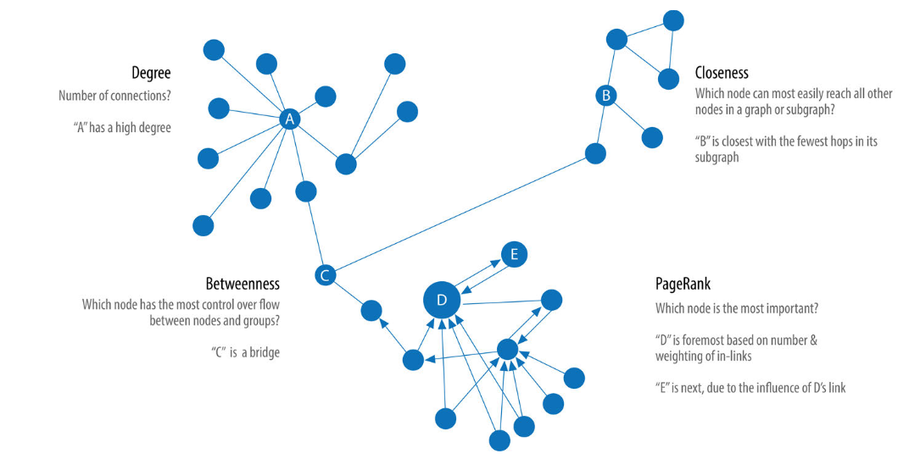
Centrality

Slide 20
Some Famous Graph Algorithms
Dijkstra’s Algorithm - single-source shortest path algo for positively weighted graphs
A* Algorithm - Similar to Dijkstra’s with added feature of using a heuristic to guide traversal
PageRank - measures the importance of each node within a graph based on the number of incoming relationships and the importance of the nodes from those incoming relationships

Slide 21
Neo4j
A Graph Database System that supports both transactional and analytical processing of graph-based data
Relatively new class of no-sql DBs
Considered schema optional (one can be imposed)
Supports various types of indexing
ACID compliant
Supports distributed computing
Similar: Microsoft CosmoDB, Amazon Neptune

Slide 22
??

